Slide 1

Tinkering & Mentoring - VACC 201
Problem Identification, Ideation & Initial Design
Neem based pesticide
Date (21/03/2026)
Name of the Presenter:Vatsal Kothari
Email Id:25sc02093@gsfcuniversity.ac.in
Mobile No.:8141343048
Faculty Mentor Name:Dr. ANKIT SIR
Team No.: 16
Semester: 2nd
Program:Bsc. Biotechnology
School: School of Science

Slide 2
Title of Idea
Student Team
Name | Enrollment No. | Key Responsibility
Vatsal Kothari | 25sc0293 | Presentation, research
Vidhi Patel | 25sc0294 | Idea, research, prototype
Yashraj Chauhan | 25sc0296 | research
Nongshaba Hijam | 25sc0297 | research
Tithi Patel | 25sc0298 | Prototype, research

Slide 3
Title of Idea
Faculty Mentor
Name | Designation | Department, School
Dr. Ankit Sudhir | Sr. Assistant professor | Life sciences, SOS

Slide 4
Title of Idea
Brief of Tinkering Project
Title of Tinkering Project:Neem based pesticide
Sector:Agriculture and Farming
Brief of Tinkering Project: Background of the project, problem/opportunity identified, Importance/Relevance of the problem/opportunity

Slide 5
Title of Idea
Objective
Make a pesticide with natural ingredients which works for almost all the types of plants and works on pests causing microbes.
To overcome buying different pesticides for the farmers and be a most cost effective.
Easy to use and requires low maintainance.

Slide 6
Title of Idea
USP/ Novelty/ Unique Points of Tinkering Project
The main ingredient used is neem extract which helps in protection from the pests.
preparation:-100g neem seed powder
soak in 1L water(for ~12-24 Hrs)
filter it
It also has UV Protectants
preparation:-lignin (0.5 – 1 %) (optional)
Kaolin Clay (1 – 2%)(optional)
Activated Charcoal (0.2 – 0.5%)
It uses attractants like Jaggery/Molasses/Sucrose) to attract pests.
(should be very little)
Main mechanism of the idea:-Neem pesticide + pest = Attract and kill system.
[Microbes survive longer on leaf surface.i.e,Fewer sprays]

Slide 7

Title of Idea
Procedure:-
of attractants(Jaggery/molasses/spreader)
Add Neem exctract from neem seeds(soak in water for 1 day and filter it)
Add UV protectants (Activated charcoal)
Mix both and stir it.
Addition natural sticker/spreader
>0.5 % Soap solution (potassium soap) as a natural sticker or spreader
>Plant oil emulsifier
>Liquid castile soap (natural{coconut and olive based oil})
Add color indicators
>Turmeric extract
>Red Cabbage
Self life enhancer
neem degraded during storage so for that we have vitamin C ( ascorbic acid )
citric acid ( very mild )
Anti wash ( rain fast )
aloe vera or starch

Slide 8
Title of Idea
Packaging/Dosage
Use opaque / UV- resistant sachets
Store in cool and dry
Self life :- 6 – 12 months
1 sachet 15L water
Spraying dosage
Spray in morning/evening
Repeat the cycle every 7 – 10 days

Slide 9
Title of Idea
BENEFITS :
FSGEco-Friendly & SafeMade from natural neem → biodegradableSafe for:HumansAnimalsPollinators (bees, butterflies)Leaves no toxic residue
Improved UV Stability UV protectants (kaolin, lignin, charcoal) prevent breakdown of azadirachtinWorks effectively for longer time under sunlight
Slow & Controlled Release Hydrogel system releases neem graduallyProvides long-lasting protectionReduces need for frequent spraying
Attract-and-Kill Efficiency Jaggery/molasses attracts pestsIncreases contact with neemLeads to higher pest mortality
Reduced Spray Frequency Due to:UV protection slow release Farmers need fewer applications
Better Leaf Coverage Soap/emulsifier improves:SpreadingAdhesionEnsures uniform coating on leaves
Rainfast Property Additives like gum/aloe/starch help formulation stick to leaves Reduces loss due to rain or irrigation

Slide 10
Title of Idea
BENEFITS :
Shelf-Life Enhancement Vitamin C (ascorbic acid) prevents oxidationImproves storage stability (6–12 months)
Farmer-Friendly Usage Pre-measured sachet:1 sachet = 15 L waterColor indicator ensures : Correct dilution less misuse
Cost-Effective in Long Run Slightly higher initial costBUT:Fewer spraysBetter efficiency Overall cost saving
Reduced Pest Resistance Neem works by:Anti-feedantGrowth regulator Pests cannot easily develop resistance
Multi-Functional Action Acts as:RepellentFeeding inhibitorGrowth disruptor Provides broad-spectrum pest control.

Slide 11
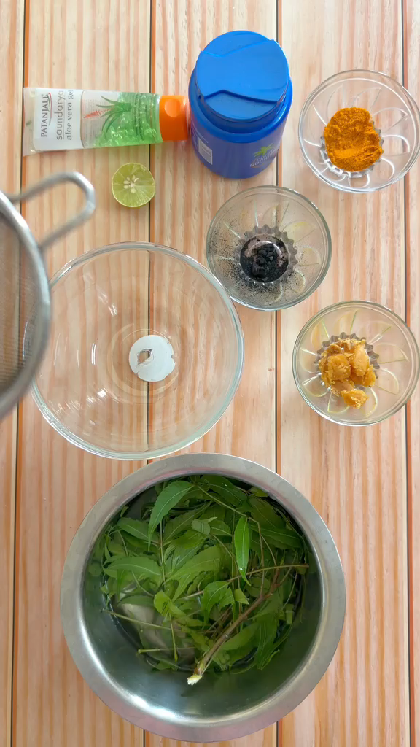

Slide 12
Thank You..

